Slide 1
Deep Learning in Image analysis Lecture 4
Takashi Sato & Tom Jhou

Slide 2


Linear classifier
$$f(x,W, b)= Wx+b$$
Weights
(10 x 3072)
Image
(3072,1)
Biases
(3072,1)
Scores
(10 x 1)
25
w_{1,1}
w_{1,2}
...
w_{1,3071}
w_{1,3072}
29
b₁
25 x w_{1,1} + …. + 72 x w_{1,3072}
+b₁
cat
w_{2,1}
w_{2,2}
...
w_{2,3071}
w_{2,3072}
b₂
25 x w_{2,1} + …. + 72 x w_{2, 3072}
+b₂
W$x b$
=
dog
+
........
......
......
......
......
w_{10,1}
w_{10,2}
...
w_{10,3071}
w_{10,3072}
119
b₁₀
+b₁₀
25 x w_{10,1} + …. + 72 x w_{10,3072}
car
72
Input
Output
w_{1,1}
25
w_{1,2}
29
11.95
w_{1,3}
12.13
......
119
...
...
......
w_{1,3072}
72
2.56
(3072)
(10)

Slide 3
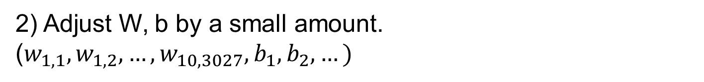
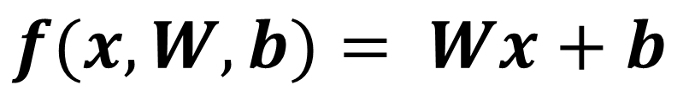
Linear classifier
$$f(x,W, b)= Wx+b$$
Using 50k training dataset, optimize W, b iteratively.
The training starts with a random values in W, b.
1) Evaluate the linear classifier (loss function).
2) Adjust W, b by a small amount.
($w_{1,1},w_{1,2}, …,w_{10,3027},b_{1},b_{2}, …)$

Slide 4
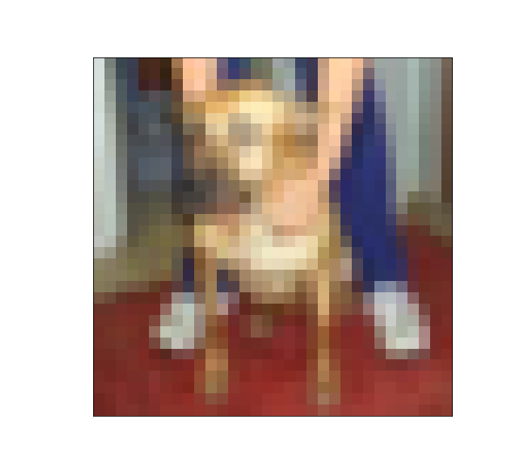
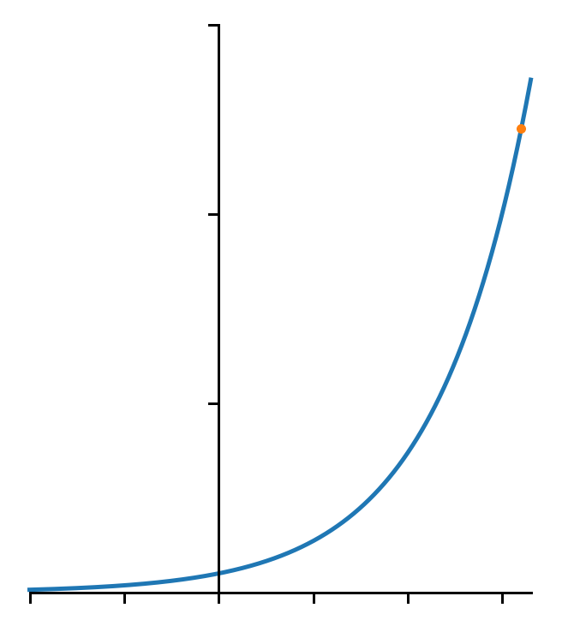




Loss function (max vs. softmax)
Image $x^{(i)}$
Convert
to > 0
Normalize
(sum = 1)
Correct
answer
Scores
cat:
3.2
24.5
0.13
0
exp
normalize
dog:
5.1
164.0
0.87
1
car:
-1.7
0.18
0.00
0
$$\frac{24.5}{24.5+164.0+0.18}$$
$$e^{3.2}=24.5$$
30
20
$$e^{x}$$
10
-2
-1
0
1
2
3

Slide 5
Loss function (max vs. softmax)
Image $x^{(i)}$
Convert
to > 0
Normalize
(sum = 1)
Correct
answer
Scores
cat:
3.2
24.5
0.13
0
exp
normalize
dog:
5.1
164.0
0.87
1
car:
-1.7
0.18
0.00
0
cat:
3.6
36.6
0.61
0
exp
normalize
dog:
2.6
13.5
0.22
1
car:
2.3
9.97
0
0.17
cat:
3.8
44.7
0.92
0
exp
normalize
dog:
-1.1
0.33
0.007
1
car:
1.3
3.67
0.08
0

Slide 6
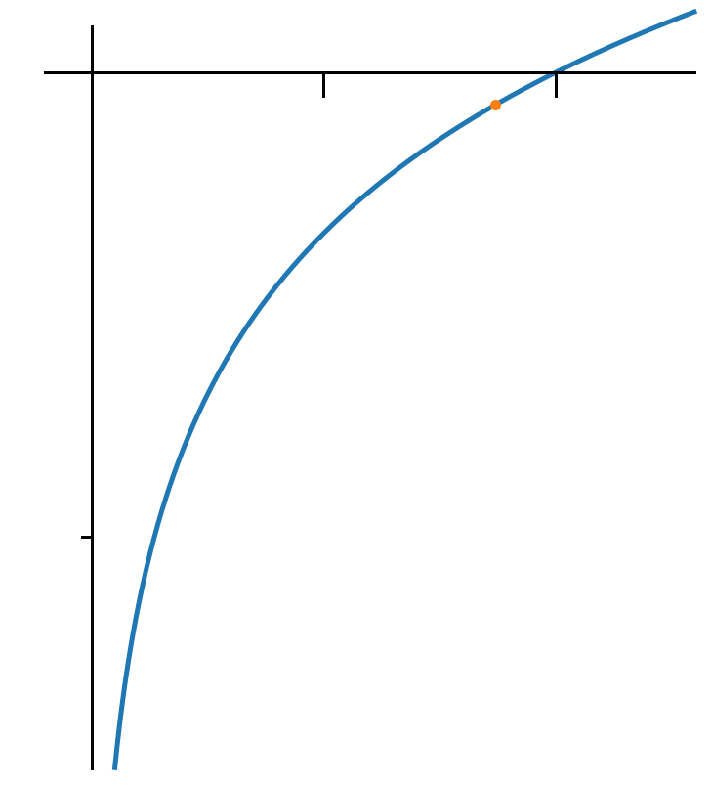

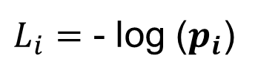
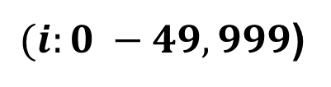

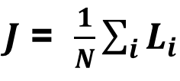
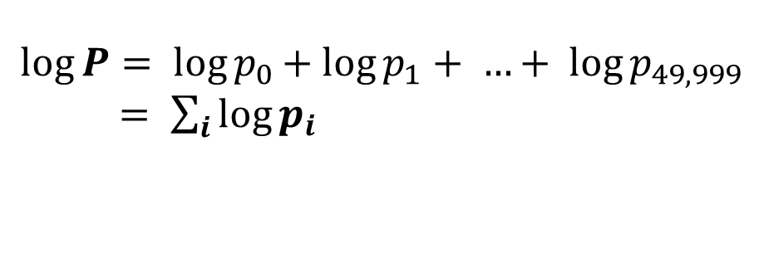
Loss function (max vs. softmax)
Image $x^{(i)}$
Convert
to > 0
Normalize
(sum = 1)
Correct
answer
Scores
cat:
3.2
24.5
0.13
0
exp
normalize
dog:
5.1
164.0
0.87
1
car:
-1.7
0.18
0.00
0
Unnormalized
log-probabilities
(logits)
Unnormalized
probabilities
Probabilities
Distance
from the target
$L_{i}=$ - log ($p_{i}$)
$${P= p}_{0}{∗ p}_{1} ∗{ p}_{2} ∗…∗{ p}_{49,999}$$
$$\log{P= \log{p_{0}}+ log{p_{1}}+ …+ \log{p_{49,999}}}$$
$= \sum_{i}{\log{p_{i}}}$
0
1
$$\log{x}$$
$J$ = $\frac{1}{N}\sum_{i}{L_{i}}$
$(i:0 −49,999$)
-2

Slide 7
Linear classifier
$$f(x,W, b)= Wx+b$$
Using 50k training dataset, optimize W, b iteratively.
The training starts with a random values in W, b.
1) Evaluate the linear classifier (loss function).
2) Adjust W, b by a small amount.
($w_{1,1},w_{1,2}, …,w_{10,3027},b_{1},b_{2}, …)$

Slide 8
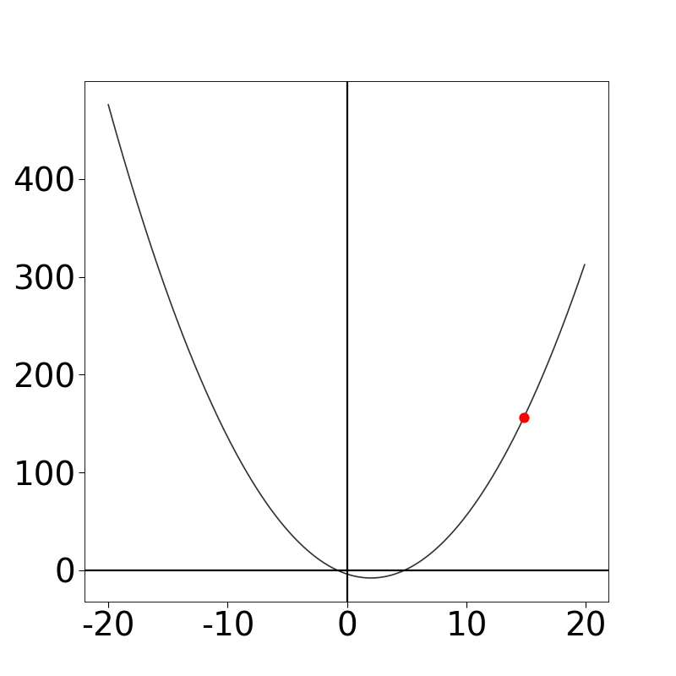
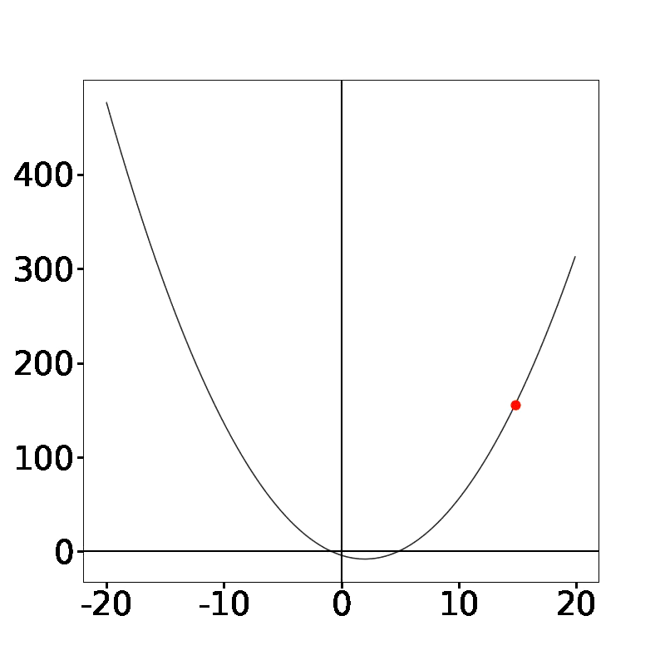


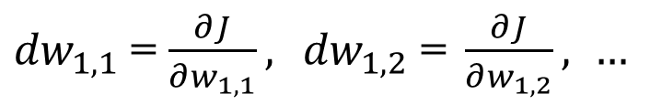
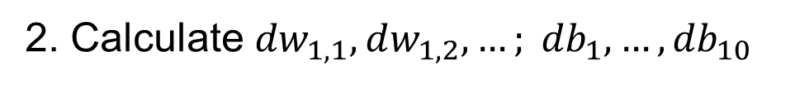
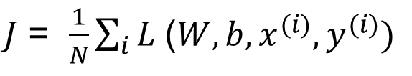
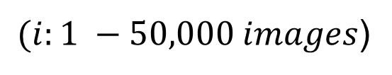


Gradient descent
Minimize with respect to W and b
$J$ = $\frac{1}{N}\sum_{i}{L \text{(}W, b, {x^{(i)},y}^{(i)})}$
$(i:1 −50,000 images$)
1. Initialize W, b with random numbers
2. Calculate ${dw}_{1,1}, dw_{1,2}, …; {db}_{1}, …,{db}_{10}$
${dw}_{1,1}$ = $\frac{∂J}{∂w_{1,1}},{ dw}_{1,2}\text{ = }\frac{∂J}{∂w_{1,2}}, …$
$$J(w)$$
3. Update W and b
$$w_{1,1}= w_{1,1} −learning_rate∗ dw_{1, 1}$$
$$w_{1,2}= w_{1,1} −learning_rate∗ dw_{1, 2}$$
$$w_{1,1}$$
…

Slide 9
Gradient descent
Minimize with respect to W and b
$J$ = $\frac{1}{N}\sum_{i}{L \text{(}W, b, {x^{(i)},y}^{(i)})}$
$(i:1 −50,000 images$)
1. Initialize W, b with random numbers
2. Calculate ${dw}_{1,1}, dw_{1,2}, …; {db}_{1}, …,{db}_{10}$
${dw}_{1,1}$ = $\frac{∂J}{∂w_{1,1}},{ dw}_{1,2}\text{ = }\frac{∂J}{∂w_{1,2}}, …$
$$J(w)$$
3. Update W and b
$$w_{1,1}= w_{1,1} −learning_rate∗ dw_{1, 1}$$
$$w_{1,2}= w_{1,1} −learning_rate∗ dw_{1, 2}$$
$$w_{1,1}$$
…
Notes:
In thst

Slide 10














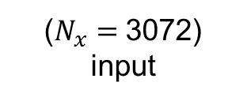
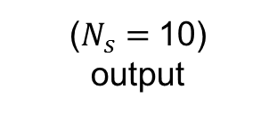

Deep network
$$x$$
$$s$$
Linear classifier
$$x_{1}$$
$$W$$
$$x_{2}$$
$$s_{1}$$
$s=Wx+ b$
$$x_{3}$$
$$s_{2}$$
......
...
$$s_{10}$$
$$(10,1)$$
$$(10,3072)$$
$$(3072,1)$$
$$x_{3072}$$
($N_{x}=$3072)
input
($N_{s}=$10)
output
Template
(10 x 3072 weights)
Score
(10 x 1 numbers)
25
w_{1,1}
w_{1,2}
...
w_{1,3071}
w_{1,3072}
29
b₁
11.95
cat
w_{2,1}
w_{2,2}
...
w_{2,3071}
w_{2,3072}
12.13
$$W x b$$
b₂
dog
+
=
........
......
......
......
......
w_{10,1}
w_{10,2}
...
w_{10,3071}
w_{10,3072}
119
b₁₀
2.56
car
72

Slide 11
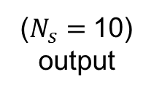



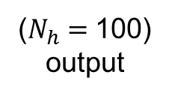






Deep network
$$x$$
$$h$$
$$s$$
Linear classifier
$$x_{1}$$
$$W_{1}$$
$$W_{2}$$
$$x_{2}$$
$s=Wx+ b$
$$x_{3}$$
...
......
...
2 layer network
$$x_{3072}$$
($N_{x}=$3072)
input
($N_{h}=$100)
output
($N_{s}=$10)
output
$h=W_{1}x+ b_{1}$
$$(100,1)$$
$$(100,3072)$$
$$(3072,1)$$
$$(100,1)$$

Slide 12





Deep network
$$x$$
$$h$$
$$s$$
Linear classifier
$$x_{1}$$
$$W_{1}$$
$$W_{2}$$
$$x_{2}$$
$s=Wx+ b$
$$x_{3}$$
...
......
...
2 layer network
$$x_{3072}$$
($N_{x}=$3072)
input
($N_{h}=$100)
output
($N_{s}=$10)
output
$h=W_{1}x+ b_{1}$
$s=W_{2}h+ b_{2}$
$$(10,1)$$
$$(10,100)$$
$$(100,1)$$
$$(10,1)$$

Slide 13






Deep network
$$x$$
$$h$$
$$s$$
Linear classifier
$$x_{1}$$
$$W_{1}$$
$$W_{2}$$
$$x_{2}$$
$s=Wx+ b$
$$x_{3}$$
...
......
...
2 layer network
$$x_{3072}$$
($N_{x}=$3072)
input
($N_{h}=$100)
output
($N_{s}=$10)
output
$h=W_{1}x+ b_{1}$
$s=W_{2}h+ b_{2}$
Why does it not work?
$s=W_{2}\left(W_{1}x+ b_{1}\right)+b_{2}$
$= W_{2}W_{1}x+(W_{2}b_{1}+b_{2})$
$$(10,100)$$
$$(100,3072)$$
$$(10,100)$$
$$(100,1)$$

Slide 14






Deep network
$$x$$
$$h$$
$$s$$
Linear classifier
$$x_{1}$$
$$W_{1}$$
$$W_{2}$$
$$x_{2}$$
$s=Wx+ b$
$$x_{3}$$
...
......
...
2 layer network
$$x_{3072}$$
($N_{x}=$3072)
input
($N_{h}=$100)
output
($N_{s}=$10)
output
$h=W_{1}x+ b_{1}$
$s=W_{2}h+ b_{2}$
Why does it not work?
$s=W_{2}\left(W_{1}x+ b_{1}\right)+b_{2}$
$= W_{2}W_{1}x+(W_{2}b_{1}+b_{2})$
$$=$$
$$W$$
$$x+$$
$$b$$
$$(10,100)$$
$$(100,3072)$$
$$(10,100)$$
$$(100,1)$$
$$(10,3072)$$
$$(10,1)$$
We end up with a linear classifier.

Slide 15
Activation function
$$x$$
$$h$$
$$s$$
Linear classifier
$$x_{1}$$
$$W_{1}$$
$$W_{2}$$
$$x_{2}$$
$s=Wx+ b$
$$x_{3}$$
...
......
...
2 layer network
$$x_{3072}$$
($N_{x}=$3072)
input
($N_{h}=$100)
output
($N_{s}=$10)
output
$h=W_{1}x+ b_{1}$
$s=W_{2}h+ b_{2}$

Slide 16


Activation function
$$x$$
$$h$$
$$s$$
Linear classifier
$$x_{1}$$
$$W_{1}$$
$$W_{2}$$
$$x_{2}$$
$s=Wx+ b$
$$x_{3}$$
...
......
...
2 layer network
$$x_{3072}$$
($N_{x}=$3072)
input
($N_{h}=$100)
output
($N_{s}=$10)
output
$h=W_{1}x+ b_{1}$
$a= max(0, h)$
$s=W_{2}h+ b_{2}$

Slide 17

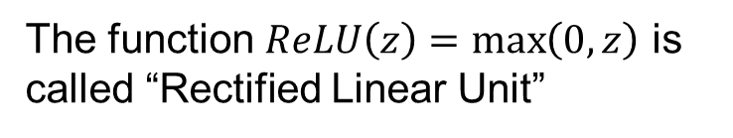

Activation function
$$x$$
$$h$$
$$s$$
Linear classifier
$$x_{1}$$
$$W_{1}$$
$$W_{2}$$
$$x_{2}$$
$s=Wx+ b$
$$x_{3}$$
...
......
...
2 layer network
$$x_{3072}$$
($N_{x}=$3072)
input
($N_{h}=$100)
output
($N_{s}=$10)
output
$h=W_{1}x+ b_{1}$
$a= max(0, h)$
$s=W_{2}a+ b_{2}$
$s=W_{2}max\left(0, W_{1}x+ b_{1}\right)+b_{2}$
5
Activation function
The function $ReLU\left(z\right)=\max\left(0, z\right)$ is called “Rectified Linear Unit”
-5
5

Slide 18


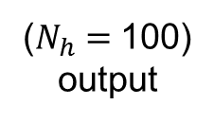


Activation function
$$x$$
$$h$$
$$s$$
Linear classifier
$$x_{1}$$
$$W_{1}$$
$$W_{2}$$
$$x_{2}$$
$s=Wx+ b$
$$x_{3}$$
...
......
...
2 layer network
$$x_{3072}$$
($N_{x}=$3072)
input
($N_{h}=$100)
output
($N_{s}=$10)
output
$h=W_{1}x+ b_{1}$
$a= max(0, h)$
$s=W_{2}a+ b_{2}$
$$w_{2,1}x_{1}$$
$$h_{2}$$
$s=W_{2}max\left(0, W_{1}x+ b_{1}\right)+b_{2}$
Activation function
$$w_{2,2}x_{2}$$
∑
….
output
The function $ReLU\left(z\right)=\max\left(0, z\right)$ is called “Rectified Linear Unit”
$$w_{2,3072}x_{3072}$$

Slide 19




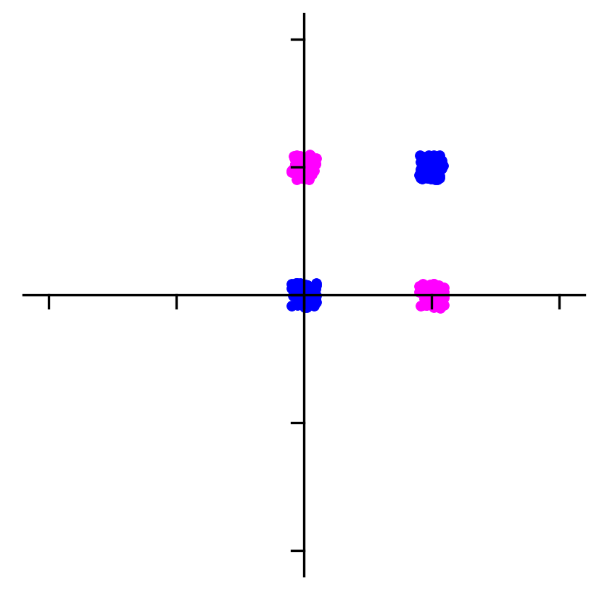




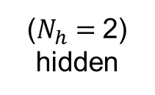



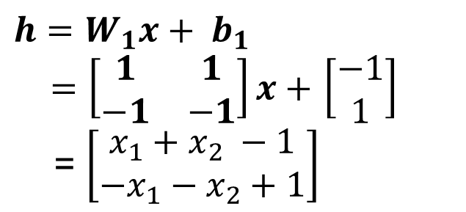
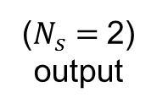



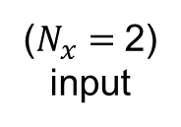







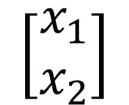




How does activation function help?
Input image
$$x$$
$$W_{1}$$
$$h$$
$$W_{2}$$
$$s$$
$$\left[\begin{matrix}x_{1} \\ x_{2}\end{matrix}\right]$$
$$0$$
$$0$$
$$1$$
$$1$$
$$x_{1}$$
$$x_{2}$$
$$0$$
$$1$$
$$0$$
$$1$$
($N_{x}=$2)
input
($N_{h}=$2)
hidden
($N_{s}=$2)
output
A
B
B
A
$h=W_{1}x+ b_{1}$
$$x_{2}$$
$a= max(0, h)$
$$h=W_{1}x+ b_{1}$$
$=\left[\begin{matrix}1 & 1 \\ −1 & −1\end{matrix}\right]x+$ $\left[\begin{matrix}−1 \\ 1\end{matrix}\right]$
= $\left[\begin{matrix}x_{1}+x_{2} −1 \\ {−x}_{1}−x_{2}+1\end{matrix}\right]$
1
$$h_{1}$$
0
1
$$x_{1}$$
$$h_{2}$$

Slide 20
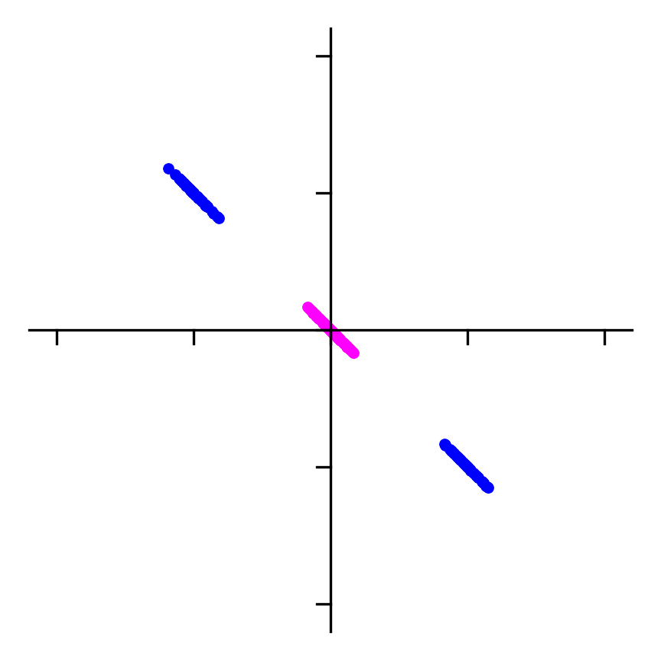
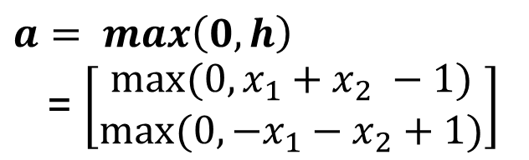




How does activation function help?
Input image
$$x$$
$$W_{1}$$
$$h$$
$$W_{2}$$
$$s$$
$$\left[\begin{matrix}x_{1} \\ x_{2}\end{matrix}\right]$$
$$0$$
$$0$$
$$1$$
$$1$$
$$x_{1}$$
$$x_{2}$$
$$0$$
$$1$$
$$0$$
$$1$$
($N_{x}=$2)
input
($N_{h}=$2)
hidden
($N_{s}=$2)
output
A
B
B
A
$h=W_{1}x+ b_{1}$
$$h_{2}$$
$a= max(0, h)$
$$h=W_{1}x+ b_{1}$$
$=\left[\begin{matrix}1 & 1 \\ −1 & −1\end{matrix}\right]x+$ $\left[\begin{matrix}−1 \\ 1\end{matrix}\right]$
= $\left[\begin{matrix}x_{1}+x_{2} −1 \\ {−x}_{1}−x_{2}+1\end{matrix}\right]$
1
$$h_{1}$$
0
1
$$h_{1}$$
$$h_{2}$$
$$a= max\left(0, h\right)$$
= $\left[\begin{matrix}{max⁡(0, x}_{1}+x_{2} −1) \\ max⁡(0, {−x}_{1}−x_{2}+1)\end{matrix}\right]$
$$a_{1}$$
$$a_{2}$$

Slide 21
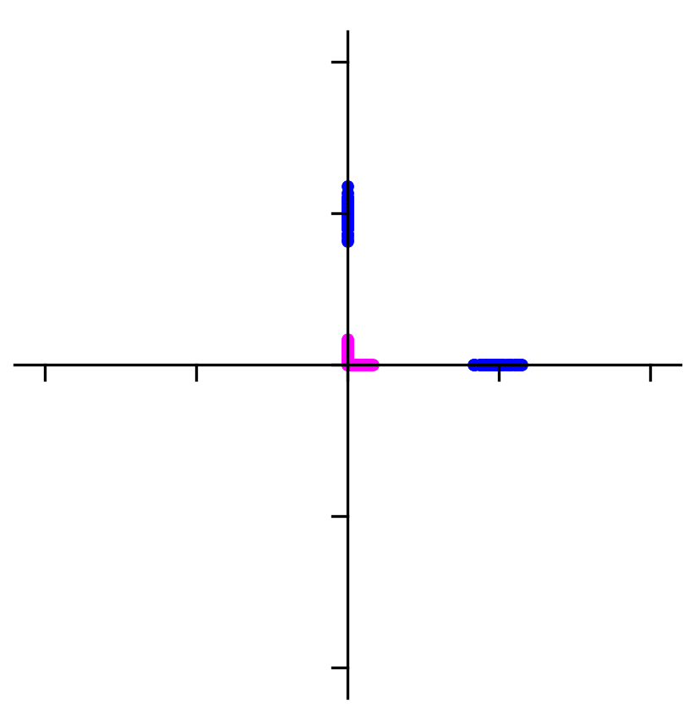


How does activation function help?
Input image
$$x$$
$$W_{1}$$
$$h$$
$$W_{2}$$
$$s$$
$$\left[\begin{matrix}x_{1} \\ x_{2}\end{matrix}\right]$$
$$0$$
$$0$$
$$1$$
$$1$$
$$x_{1}$$
$$x_{2}$$
$$0$$
$$1$$
$$0$$
$$1$$
($N_{x}=$2)
input
($N_{h}=$2)
hidden
($N_{s}=$2)
output
A
B
B
A
$h=W_{1}x+ b_{1}$
$$a_{2}$$
$a= max(0, h)$
$$h=W_{1}x+ b_{1}$$
$=\left[\begin{matrix}1 & 1 \\ −1 & −1\end{matrix}\right]x+$ $\left[\begin{matrix}−1 \\ 1\end{matrix}\right]$
= $\left[\begin{matrix}x_{1}+x_{2} −1 \\ {−x}_{1}−x_{2}+1\end{matrix}\right]$
1
$$h_{1}$$
0
1
$$a_{1}$$
$$h_{2}$$
$$a= max\left(0, h\right)$$
= $\left[\begin{matrix}{max⁡(0, x}_{1}+x_{2} −1) \\ max⁡(0, {−x}_{1}−x_{2}+1)\end{matrix}\right]$
$$a_{1}$$
$$a_{2}$$

Slide 22
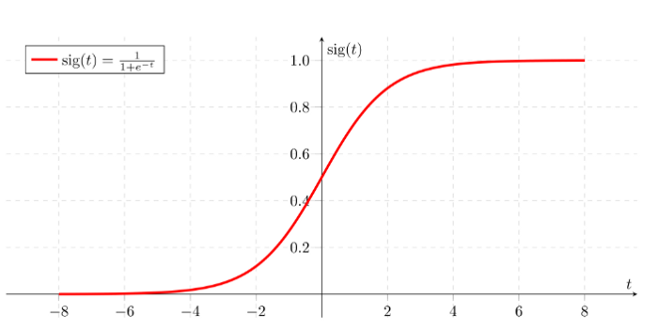
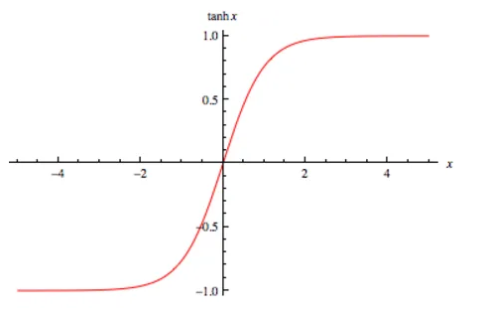
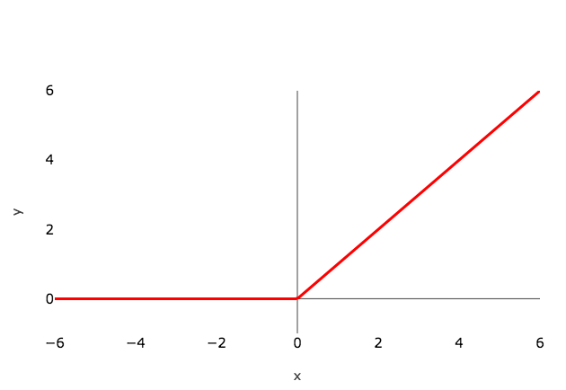
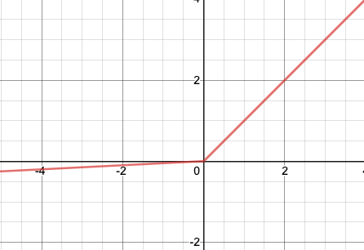




Activation function
$$\frac{e^{z}− e^{−z}}{e^{z}+ e^{−z}}$$
$$\frac{1}{1+ e^{−z}}$$
$$max(0,z)$$
$$max(0.1∗z,z)$$

Slide 23

Deep network
$$x$$
$$h$$
$$s$$
Linear classifier
$$x_{1}$$
$$W_{1}$$
$$W_{2}$$
$$x_{2}$$
$s=Wx+ b$
$$x_{3}$$
...
......
...
2 layer network
$$x_{3072}$$
($N_{x}=$3072)
input
($N_{h}=$100)
output
($N_{s}=$10)
output
$h=W_{1}x+ b_{1}$
$a= max(0, h)$
$s=W_{2}a+ b_{2}$
1. Initialize $W_{1} (100×3072), b_{1}(100×1),{W_{2}(10×100),b}_{2}(10×1)$
2. Evaluate the network (calculate Loss Function)
3. Update $W_{1}, b_{1},{W_{2},b}_{2}$

Slide 24
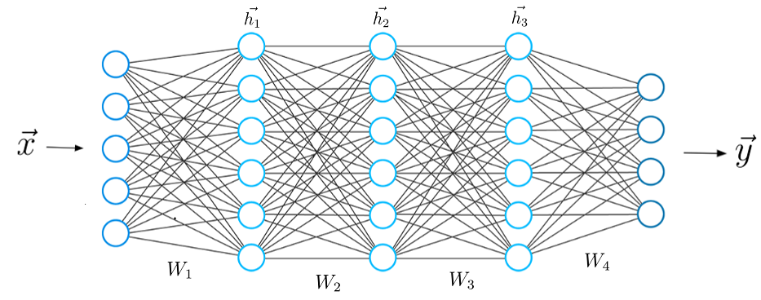
Deep network
$$x$$
$$h$$
$$s$$
Linear classifier
$$x_{1}$$
$$W_{1}$$
$$W_{2}$$
$$x_{2}$$
$s=Wx+ b$
$$x_{3}$$
...
......
...
2 layer network
$$x_{3072}$$
($N_{x}=$3072)
input
($N_{h}=$100)
output
($N_{s}=$10)
output
$h=W_{1}x+ b_{1}$
$a= max(0, h)$
$s=W_{2}a+ b_{2}$
1. Initialize $W_{1} (100×3072), b_{1}(100×1),{W_{2}(10×100),b}_{2}(10×1)$
2. Evaluate the network (calculate Loss Function)
3. Update $W_{1}, b_{1},{W_{2},b}_{2}$

Slide 25
Tensorflow
Define the architecture:
XX = tf.keras.Model(inputs = , outputs =).
Compile:
XX = XX.compile(optimizer = , loss = , metrics = )
Fit:
XX = XX.fit(x= , y= , batch_size= , epochs= )
Predict:
XX = XX.predict(x= )
Evaluate:
XX = XX.evaluate(x= , y=)

